Slide 1
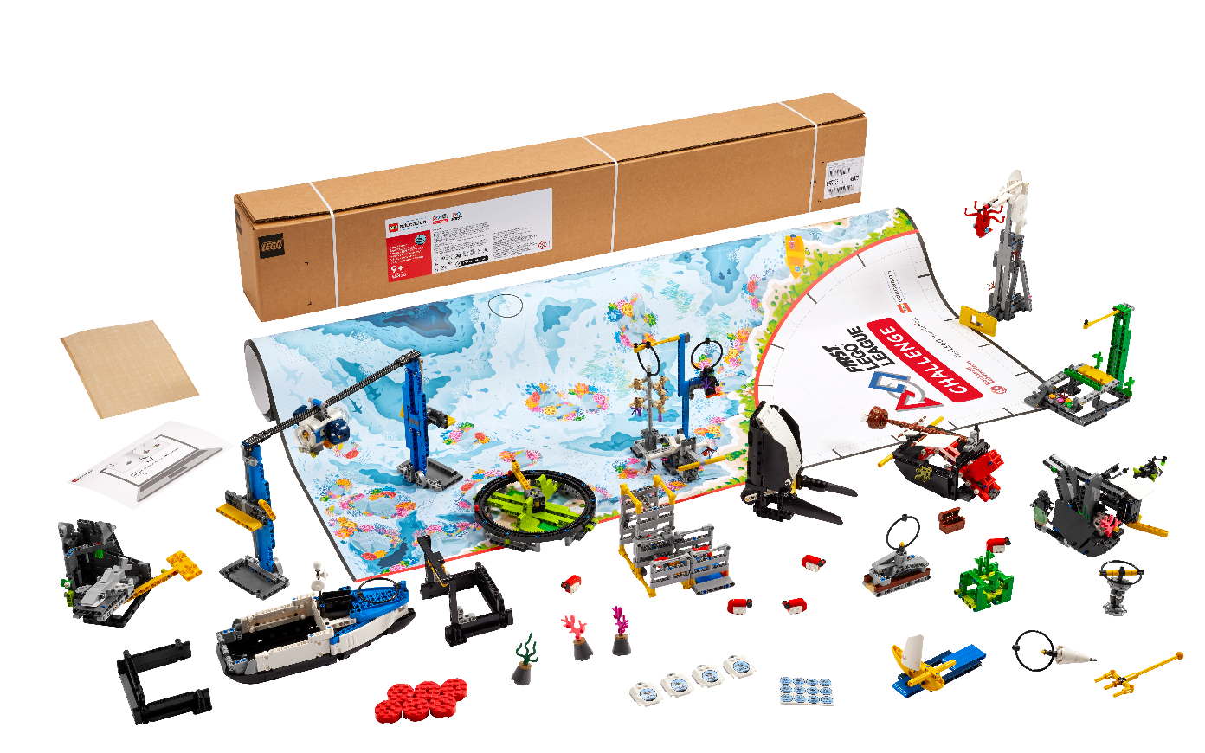


Session 1
Get Started
Notes:
Session 1 Tips =
Have the team watch the season videos on the FIRST® LEGO® League YouTube channel and read pages 3-9 in their Engineering Notebooks.
Two devices are suggested, one for the robot and one for project work. Additional devices for the mission model building are useful.
Activities in the sessions use the LEGO Education SPIKE™ Prime app.
Make sure the controller and device are plugged in and charging at the end of the session.
Robot Game Connection: Have the team think about how a sensor could be helpful to get the robot to stop in the right place to engage with a mission model on the mat.

Slide 2
Session Overview
Outcomes
Explore the SUBMERGEDSM season theme and get to know each other.
Make connections from the mission models to the Challenge story and Project Sparks.
Notes:
Facilitator Tips
Each session in this guide takes approximately two hours. If needed, split each session into two separate 60-minute meetings.
Session 1 Tips
Have the team watch the season videos on the FIRST ® LEGO® League YouTube channel and read pages 3-11 in their Engineering Notebooks.
Provide the digital model building instructions to the team.
The team can work together or as individuals to build the models. Be sure to inspect and test the models to ensure they function correctly.
Encourage the team to investigate the mat and the mission models to inspire them. The team should record ideas for possible innovation projects that they could choose.
Encourage and support discussion about the Challenge story and Project Sparks and how they relate to the mission models.

Slide 3
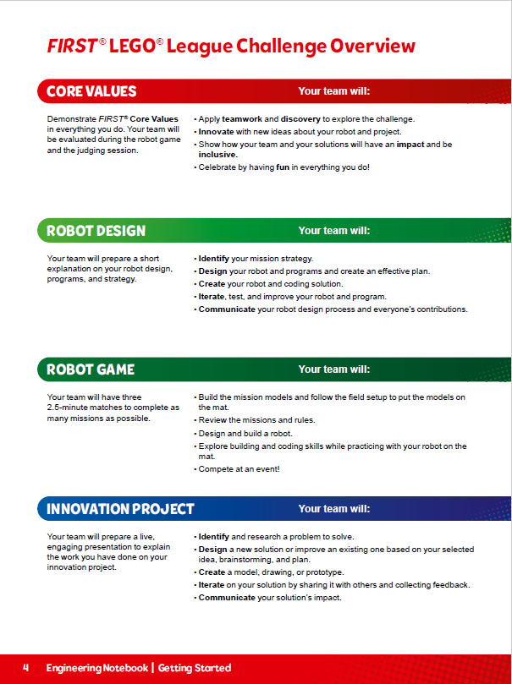
Introduction
Watch the season videos and read pages 3-11 to learn how FIRST® LEGO® League Challenge works and about the SUBMERGEDSM robot game and innovation project.
Get to know your team members and select your team name.
Notes:
Introduction (10-15 minutes)
Have the team watch the season videos on the FIRST® LEGO® League YouTube channel and read pages 3-11 in their Engineering Notebooks.
Get to know your team members and select your team name.
Visit the FIRST® LEGO ® League YouTube Channel to watch the SUBMERGEDSM season launch video
Session 1 Tips =
Have the team watch the season videos on the FIRST ® LEGO® League YouTube channel and read pages 3-11 in their Engineering Notebooks.
Provide the digital model building instructions to the team.
The team can work together or as individuals to build the models. Be sure to inspect and test the models to ensure they function correctly.
Encourage the team to investigate the mat and the mission models to inspire them. The team should record ideas for possible innovation projects that they could choose.
Encourage and support discussion about the Challenge story and Project Sparks and how they relate to the mission models.

Slide 4

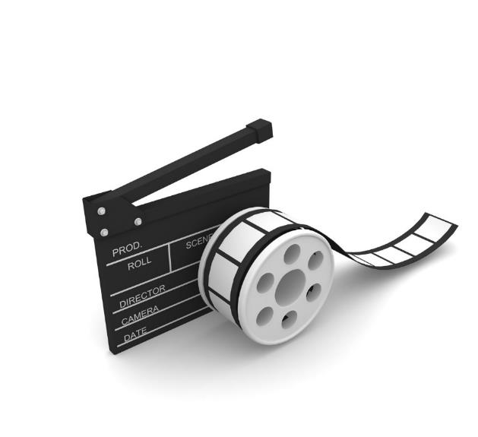
Visit the
FIRST® LEGO® League
YouTube Channel
to watch the
SUBMERGEDSM season launch video
Notes:
Facilitator Tips
Each session in this guide takes approximately two hours. If needed, split each session into two separate 60-minute meetings.
Session 1 Tips
Have the team watch the season videos on the FIRST ® LEGO® League YouTube channel and read pages 3-11 in their Engineering Notebooks.
Provide the digital model building instructions to the team.
The team can work together or as individuals to build the models. Be sure to inspect and test the models to ensure they function correctly.
Encourage the team to investigate the mat and the mission models to inspire them. The team should record ideas for possible innovation projects that they could choose.
Encourage and support discussion about the Challenge story and Project Sparks and how they relate to the mission models.

Slide 5
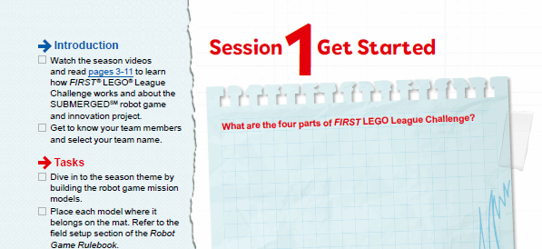

Introduction
Watch the season videos and read pages 3-11 on how FIRST® LEGO® League Challenge works and the SUBMERGEDSM challenge.
Notes:
Visit the FIRST® LEGO ® League YouTube Channel to watch the SUBMERGEDSM season launch video
Facilitator Tips
Each session in this guide takes approximately two hours. If needed, split each session into two separate 60-minute meetings.
Session 1 Tips
Have the team watch the season videos on the FIRST ® LEGO® League YouTube channel and read pages 3-11 in their Engineering Notebooks.
Provide the digital model building instructions to the team.
The team can work together or as individuals to build the models. Be sure to inspect and test the models to ensure they function correctly.
Encourage the team to investigate the mat and the mission models to inspire them. The team should record ideas for possible innovation projects that they could choose.
Encourage and support discussion about the Challenge story and Project Sparks and how they relate to the mission models.

Slide 6

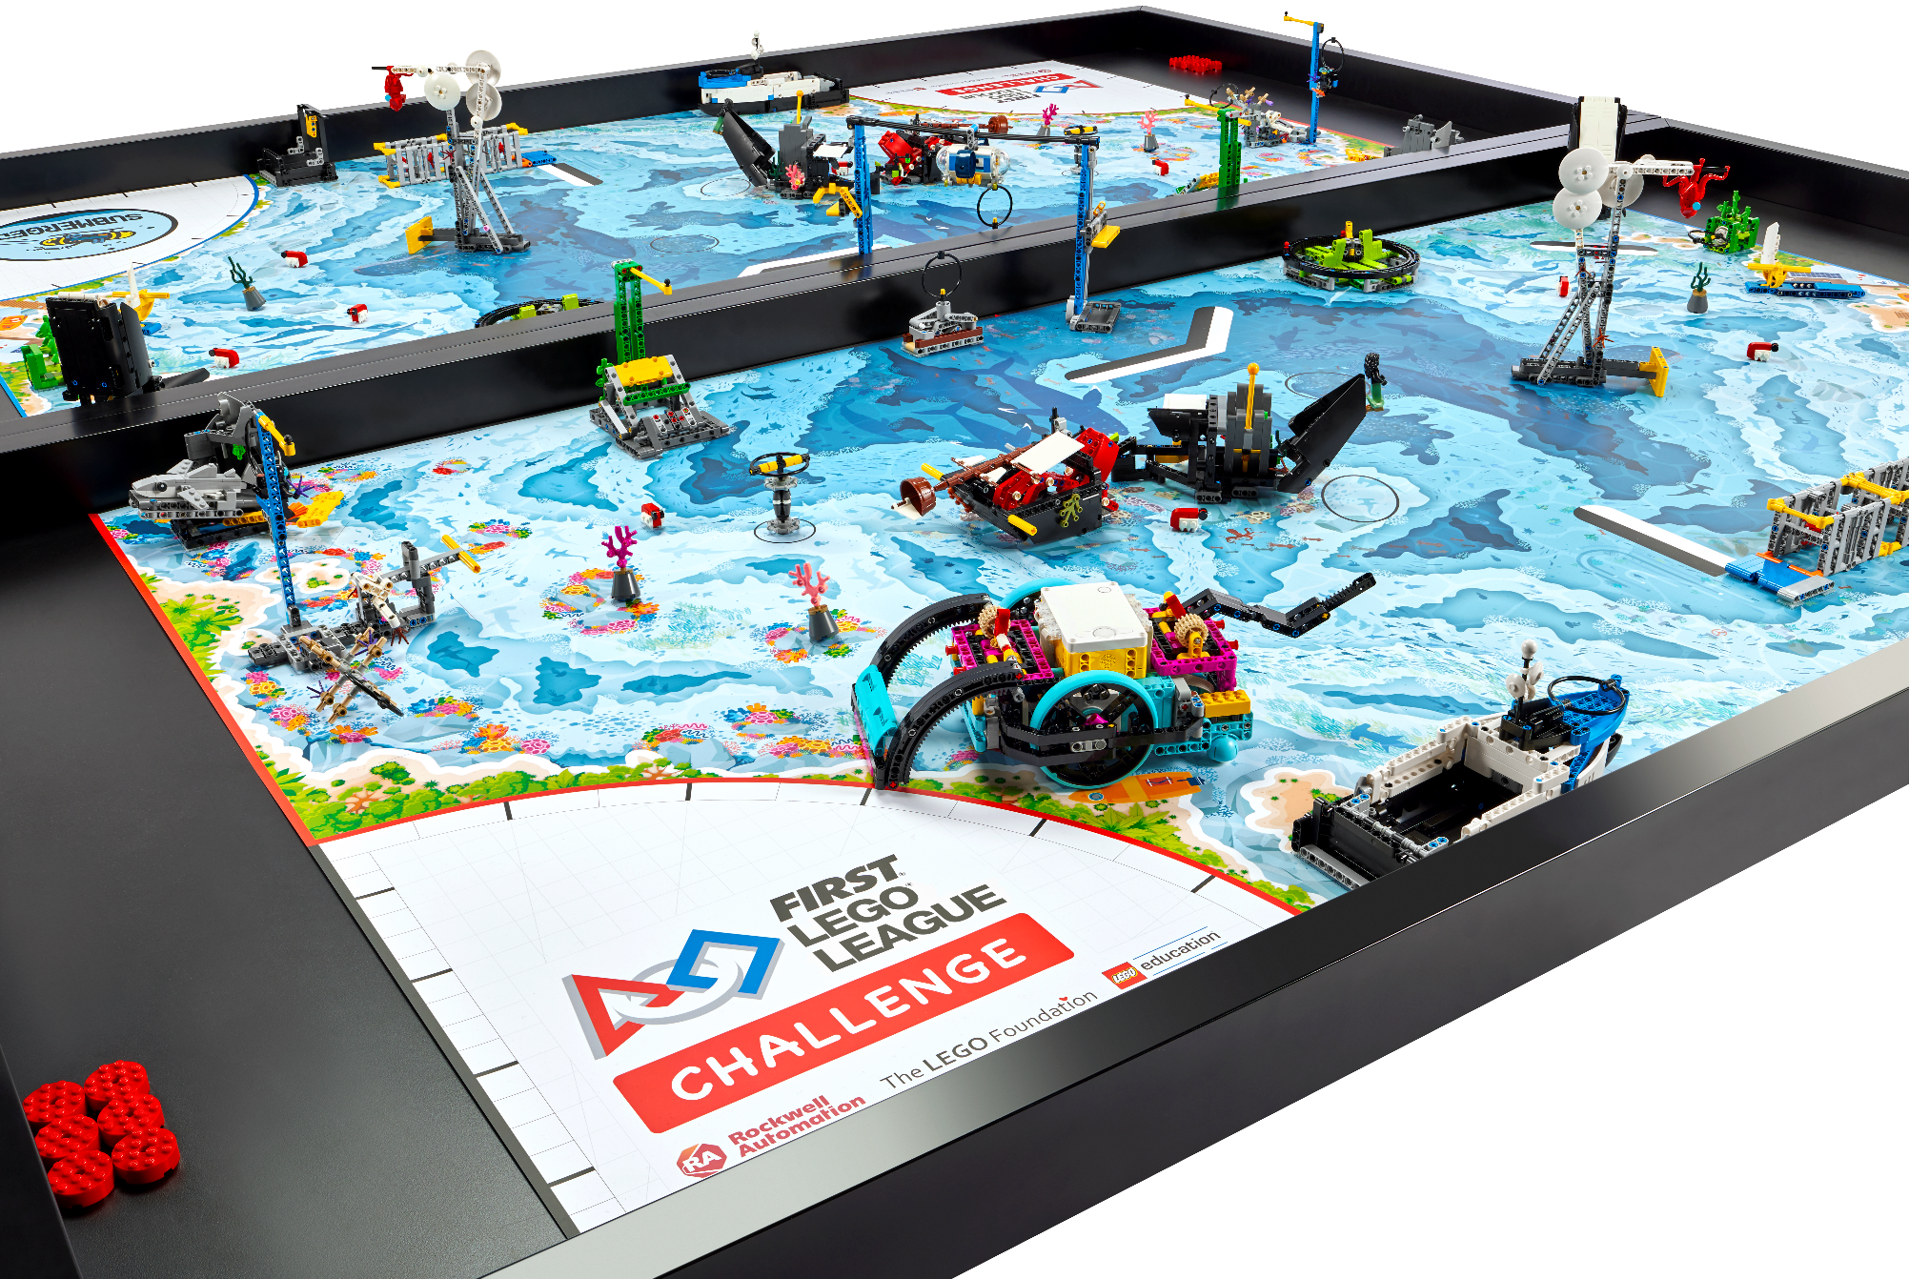
Tasks
Dive in to the season theme by building the robot game mission models.
Place each model where it belongs on the mat. Refer to the field setup section of the Robot Game Rulebook.
Notes:
Visit the FIRST® LEGO ® League YouTube Channel to watch the SUBMERGEDSM season launch video
Facilitator Tips
Each session in this guide takes approximately two hours. If needed, split each session into two separate 60-minute meetings.
Session 1 Tips
Have the team watch the season videos on the FIRST ® LEGO® League YouTube channel and read pages 3-11 in their Engineering Notebooks.
Provide the digital model building instructions to the team.
The team can work together or as individuals to build the models. Be sure to inspect and test the models to ensure they function correctly.
Encourage the team to investigate the mat and the mission models to inspire them. The team should record ideas for possible innovation projects that they could choose.
Encourage and support discussion about the Challenge story and Project Sparks and how they relate to the mission models.

Slide 7
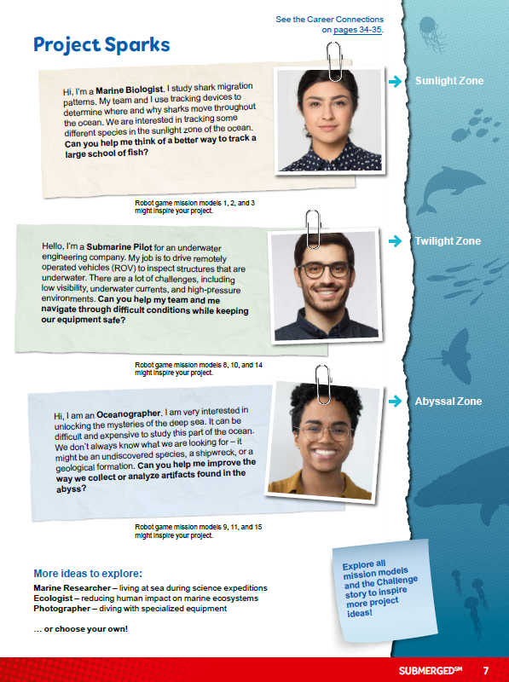
Tasks
Explore how the models work and how they might connect to the Project Sparks on page 7.
Notes:
Visit the FIRST® LEGO ® League YouTube Channel to watch the SUBMERGEDSM season launch video
Facilitator Tips
Each session in this guide takes approximately two hours. If needed, split each session into two separate 60-minute meetings.
Session 1 Tips
Have the team watch the season videos on the FIRST ® LEGO® League YouTube channel and read pages 3-11 in their Engineering Notebooks.
Provide the digital model building instructions to the team.
The team can work together or as individuals to build the models. Be sure to inspect and test the models to ensure they function correctly.
Encourage the team to investigate the mat and the mission models to inspire them. The team should record ideas for possible innovation projects that they could choose.
Encourage and support discussion about the Challenge story and Project Sparks and how they relate to the mission models.

Slide 8
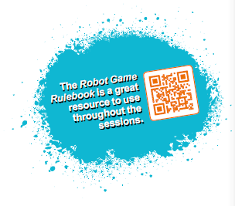

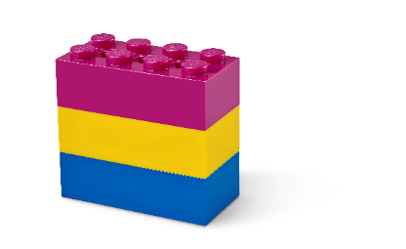
Reflection Questions
How could stopping a motor help you solve a mission with your robot?
What do you know about your teammates’ interests and hobbies?
What are resources that can help you learn more?
Read over the Robot Game Rulebook for all the details on the missions.
Notes:
Team Tasks (100-120 minutes)
Facilitator Tips
Have the team watch the season videos on the FIRST® LEGO® League YouTube channel and read pages 3-9 in their Engineering Notebooks.
Two devices are suggested, one for the robot and one for project work. Additional devices for the mission model building are useful.
Activities in the sessions use the LEGO Education SPIKE™ Prime app.
Make sure the controller and device are plugged in and charging at the end of the session.
Robot Game Connection: Have the team think about how a sensor could be helpful to get the robot to stop in the right place to engage with a mission model on the mat.

Slide 9
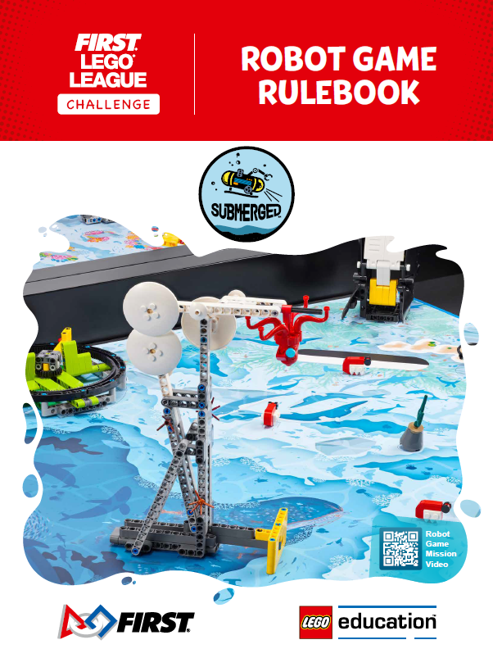
Robot Game Rulebook
Check out the Robot Game Rulebook. This will be a great resource throughout the sessions.
Review the missions that relate to the models you built.

Slide 10

Share
Get together at the mat.
Show how the mission models connect to the SUBMERGEDSM theme.
Discuss the reflection questions.
Clean up your space.
Notes:
Share (10-15 minutes)
Facilitator Tips
Provide the digital building instructions for the models to the team.
The team will need Bags 3, 5, and 11 from the Challenge set. Larger pieces may be in an unnumbered LEGO® bag.
The Project Sparks are designed to give the team ideas about technology they could explore for their solution.
Encourage the team to investigate the mat and the mission models to inspire them. The team should record ideas for possible innovation projects that they could choose.
Place the completed models on the mat with Dual Lock squares according to the field setup in the Robot Game Rulebook.

Slide 11

Reflection Questions
Which mission models look the most interesting to you?
How do the models relate to the Challenge story or Project Sparks?
What resources will you use to learn more about the season theme?
Notes:
Share (10-15 minutes)
Facilitator Tips
Provide the digital building instructions for the models to the team.
The team will need Bags 3, 5, and 11 from the Challenge set. Larger pieces may be in an unnumbered LEGO® bag.
The Project Sparks are designed to give the team ideas about technology they could explore for their solution.
Encourage the team to investigate the mat and the mission models to inspire them. The team should record ideas for possible innovation projects that they could choose.
Place the completed models on the mat with Dual Lock squares according to the field setup in the Robot Game Rulebook.

Slide 12
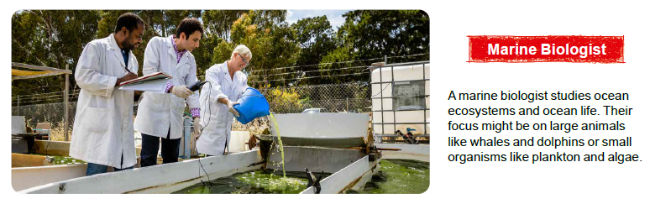
Career Connections

Slide 13

Multimedia Resources
You may wish to embed a relevant, age-appropriate video for your students here.
Notes:
Choose a relevant, age-appropriate video for your students.

Slide 14

Clean Up
Notes:
Allow time for cleanup and place any unfinished models and their pieces in a sealed plastic bag.
Clean Up Pointers
You may wish to play a video or song during clean up time Link on
GoNoodle: https://family.gonoodle.com/activities/clean-up
Link on YouTube Kids: https://www.youtubekids.com/watch?v=ZJFk87ZsHn0
Link on Youtube: https://youtu.be/ZJFk87ZsHn0

Slide 15

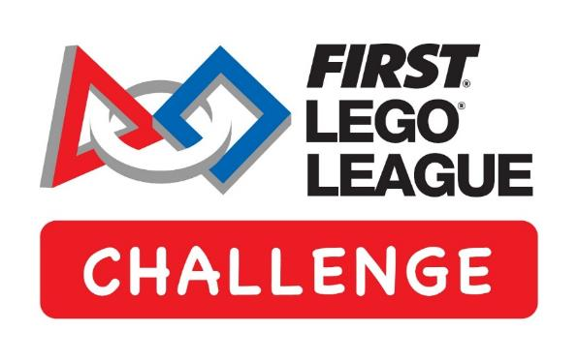
LEGO, the LEGO logo, the SPIKE logo, MINDSTORMS and the MINDSTORMS logo are trademarks of the/sont des marques de commerce du/son marcas registradas de LEGO Group. ©2024 The LEGO Group. All rights reserved/Tous droits réservés/Todos los derechos reservados. FIRST ®, the FIRST ® logo, Coopertition ®, Gracious Professionalism®, and FIRST® DIVESM are trademarks of For Inspiration and Recognition of Science and Technology (FIRST). LEGO® is a registered trademark of the LEGO Group. FIRST® LEGO® League and SUBMERGEDSM are jointly held trademarks of FIRST and the LEGO Group. All other trademarks are the property of their respective owners. ©2024 FIRST and the LEGO Group. All rights reserved.

